Slide 1
Credit card competitive research presentation template
pathfind.com

Slide 2
Conducting a Credit Card Competitive Analysis
Monitoring competitors’ strategies, offers, and positioning is crucial for staying competitive. Whether you’re looking to improve your portfolio or launch a new product, conducting a thorough competitive analysis is key to understanding the marketplace and staying relevant.
Identify your competitors
Identify issuers offering similar cards targeting the same demographics and indirect competitors who provide alternative payment methods. Check who dominates search results for similar credit cards. Analyze social media discussions in your market. Review industry reports for key players.
Research and collect competitor data
Focus on gathering details that influence consumer decisions.
Interest rates (APRs)
Fees
Rewards programs
Sign-up bonuses
Earn rates
Rewards value
APR offers
Unique features
Analyze competitor positioning
A competitor’s card features matter, but how they position it is equally important. By analyzing their messaging, branding, and positioning, you can determine what kind of narrative they are using to attract customers. Who are they targeting? What are they trying to project? What is their main selling point?
Dig in to competitor advertising strategies
Marketing channels are as important as the product. Study how competitors reach their audience through Google Ads, social media, or email. Identify the keywords they rank for and what content drives their traffic. Compare their direct mail messaging, frequency, and design, to their digital tactics.
Showcase your findings effectively
Once the competitive analysis is complete, present the information in a way that is easily digestible for stakeholders. This PowerPoint allows you to combine text, images, and links that paint a vivid picture of your findings. Embed links to competitor pages, research reports, and articles for additional context.
For further details, read our “A step-by-step guide to conducting a credit card competitive analysis” blog
NOTE: BEFORE THIS GETS POSTED, I NEED THE EXACT URL TO LINK TO FROM DEV

Slide 3
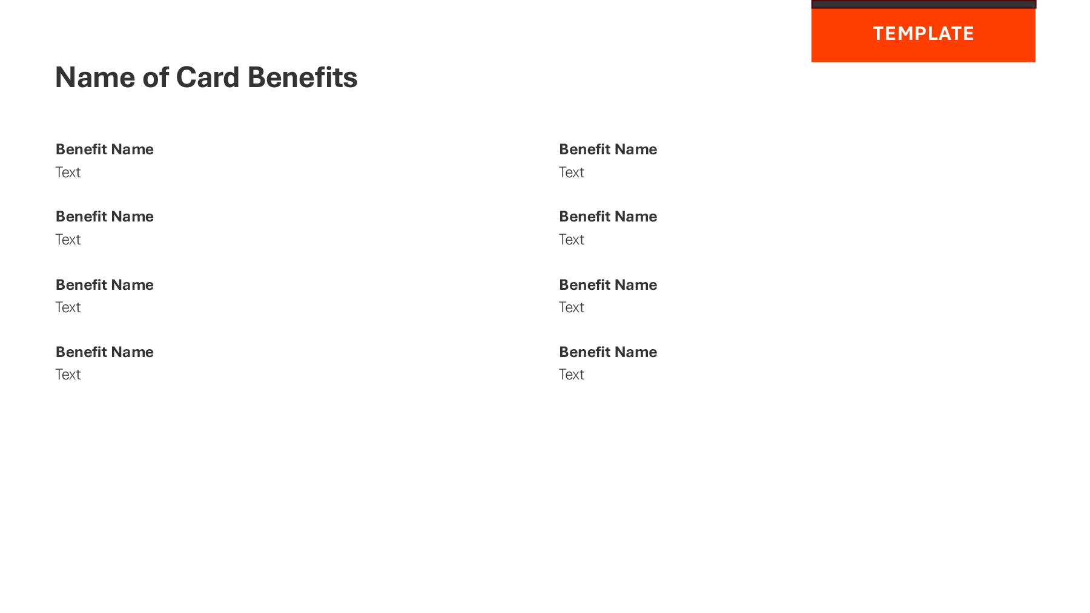
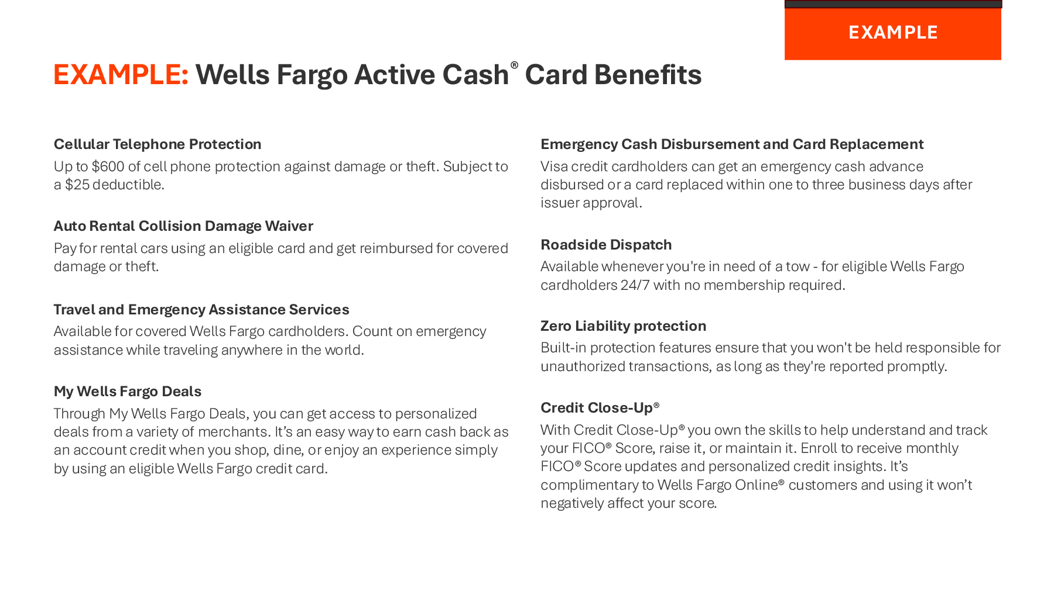
How to use this guide
Place an image of the card here.
What message is being used to differentiate this card from others in its category?
What special promotion is being used to attract new customers (0% intro APR, spend & get, etc.)?
What does this card offer (cash back, points, miles, etc.)?
Has this card been recognized with awards or rankings from reputable sources? For visual interest, include images of the awards.
Use page 4 to build your overview slide.
The example on page 6 is an ideal card overview slide.
What other benefits does this card offer (no or low fees, travel benefits, extended warranties, purchase protection, etc.)?
Use page 5 to build your benefit slide.
The example on page 7 is a benefit slide.

Slide 4
Name of Card Overview
TEMPLATE
Positioning
Text
Active Cash® Card Awards
Annual Fee: Text
APR: Text
Intro Offer
Text
Value Proposition
Text
Award Name
Text
Award Name
Text
Award Name
Text

Slide 5
Name of Card Benefits
TEMPLATE
Benefit Name
Text
Benefit Name
Text
Benefit Name
Text
Benefit Name
Text
Benefit Name
Text
Benefit Name
Text
Benefit Name
Text
Benefit Name
Text

Slide 6
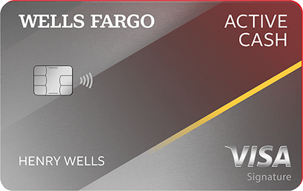
EXAMPLE: Wells Fargo Active Cash® Card Overview
EXAMPLE
Positioning
Meet our best cash back credit card ever!
Active Cash® Card Awards
Annual Fee: What is it?
APR: 20.24%, 25.24%, 29.99%
Intro Offer
Earn a $200 cash rewards bonus when you spend $500 in purchases in the first 3 months
0% intro APR for 15 months from account opening on purchases and qualifying balance transfers.
Value Proposition
Earn unlimited 2% cash rewards on purchases with no categories to track or quarterly activations
NerdWallet
2022 & 2023 Best Credit Card for Simple Cash Back
The Ascent, a Motley Fool Service
2023 Best No Annual Fee Credit Card
2022 Best Cash Back Card Overall
2022 Best No Annual Fee Cash Back Credit Card
2022 Best New Credit Card Launch
Money.com
2022 Best for Flat-Rate Rewards

Slide 7
EXAMPLE: Wells Fargo Active Cash® Card Benefits
EXAMPLE
Cellular Telephone Protection
Up to $600 of cell phone protection against damage or theft. Subject to a $25 deductible.
Auto Rental Collision Damage Waiver
Pay for rental cars using an eligible card and get reimbursed for covered damage or theft.
Travel and Emergency Assistance Services
Available for covered Wells Fargo cardholders. Count on emergency assistance while traveling anywhere in the world.
My Wells Fargo Deals
Through My Wells Fargo Deals, you can get access to personalized deals from a variety of merchants. It’s an easy way to earn cash back as an account credit when you shop, dine, or enjoy an experience simply by using an eligible Wells Fargo credit card.
Emergency Cash Disbursement and Card Replacement
Visa credit card holders can get an emergency cash advance disbursed or a card replaced within one to three business days after issuer approval.
Roadside Dispatch
Available whenever you're in need of a tow - for eligible Wells Fargo cardholders 24/7, with no membership required.
Zero Liability Protection
Built-in protection features ensure that you won't be held responsible for unauthorized transactions, as long as they're reported promptly.
Credit Close-Up®
With Credit Close-Up® you own the skills to help understand and track your FICO® Score, raise it, or maintain it. Enroll to receive monthly FICO® Score updates and personalized credit insights. It’s complimentary to Wells Fargo Online® customers and using it won’t negatively affect your score.

