Slide 1
Persona guide & template
pathfind.com

Slide 2
Creating customer personas
Customer personas represent your ideal customers. Creating personas is a systematic process that can be broken down into three main steps:
Gathering and analyzing data
Gather data about existing customers and prospects including demographics (age, gender, income, location), behavior (spending habits, credit card usage, preferred rewards), and psychographics (lifestyle, values, interests).
Segmenting by demographics, psychographics, and behaviors
Group target audiences by characteristics like demographics, psychographics, behaviors, and communication preferences. Segmentation allows you to identify distinct groups and create tailored personas.
Crafting the persona
Create narratives that bring your target to life and help your team visualize their preferences and behaviors. Assign relatable names like "Ethan” or “Megan” to make them relatable and easy to reference.
For further details, read our “Elevate your credit card marketing with personas” blog

Slide 3
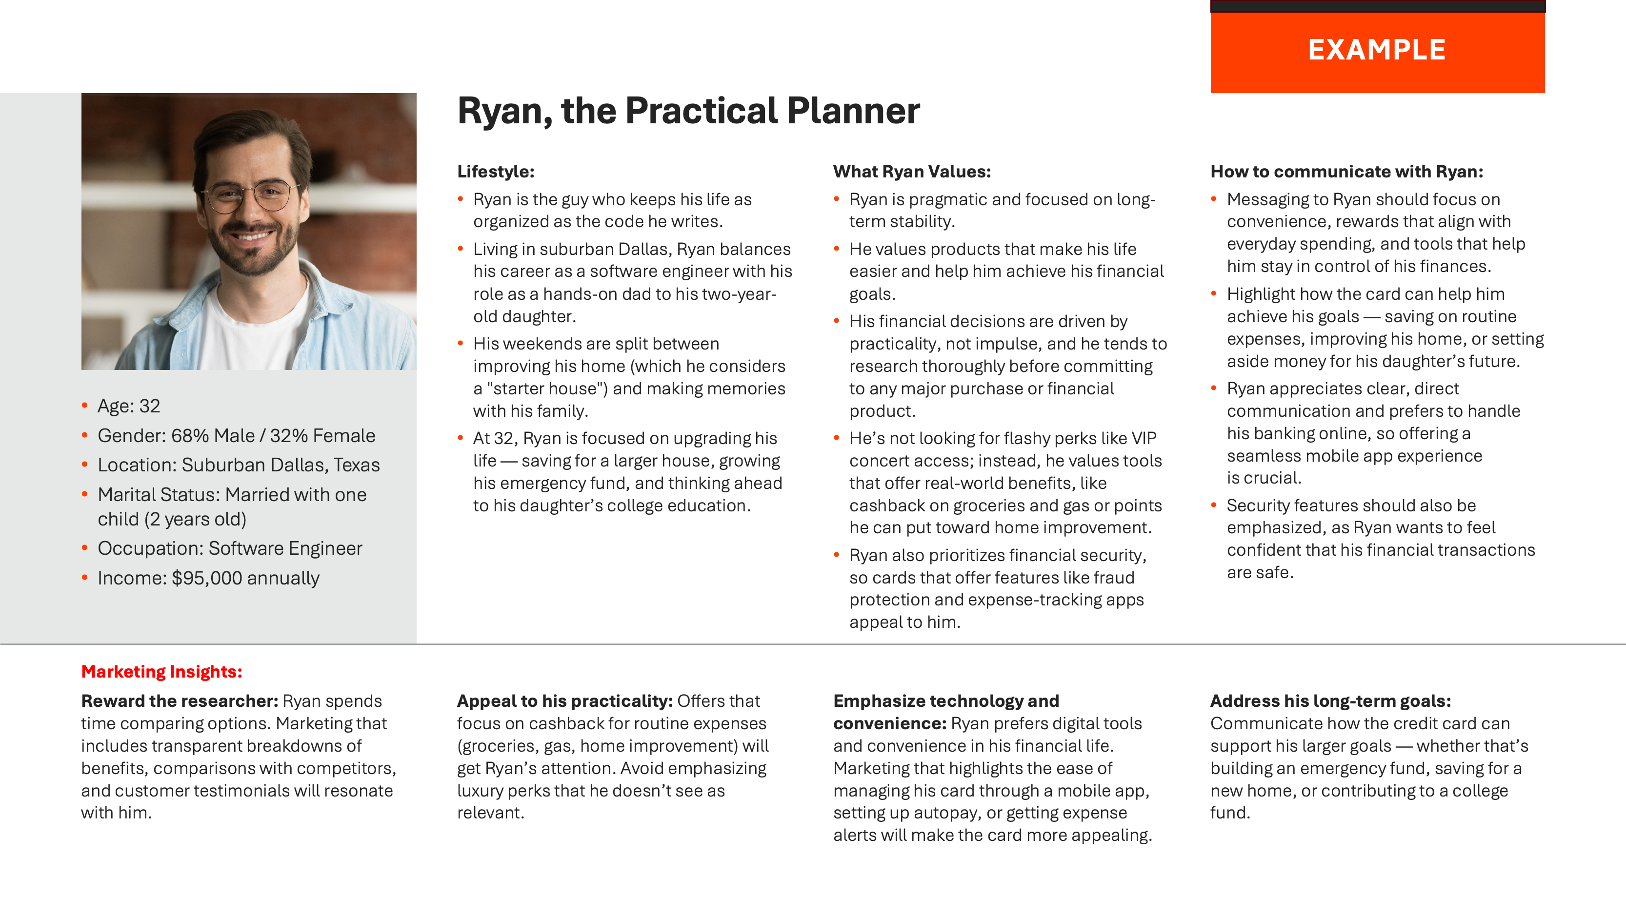
How to use this guide
The name should feel real and represent the persona’s traits and demographics. The descriptor should provide a quick summary of the persona in a few memorable words.
These sections include thought starters and questions designed to help you craft the ideal persona by interpreting the target's lifestyle and values through compelling storytelling narratives.
Select an image that reflects the persona’s age, gender, profession, or interests.
Place the demographic data here.
Use page 5 to start building your persona.
Use the worksheet on page 4 to organize your findings.
Once you have a clear understanding of the target's lifestyle and values, use the questions in this section to tailor your marketing messages and card program benefits specifically for this persona.
The example on page 6 is an ideal persona for reference.

Slide 4
WORKSHEET
What do you imagine this person looks like?
Persona’s name and descriptor
Lifestyle:
Thought starters:
What are their daily routines and habits?
Where do they live (urban, suburban, rural)? What is their home like (apartment, starter house, etc.)?
What is their profession and how does their work-life balance affect their lifestyle?
How do they spend their free time? Are they highly social or more introverted?
Who makes up their primary social circle (friends, family, coworkers)?
What matters most to them (family, career, personal growth, community)?
Are they risk-averse or adventurous?
What [Name] values:
Thought starters:
What are their long-term goals?
What type of products do they value (simple, time-saving, those that make life easier, etc.)?
How do they approach financial decisions (practical, emotional, impulsive, analytical, etc.)?
What do they seek in a card — prestige, security, flashy perks, or practical benefits?
What do they prioritize when making decisions (security, ease of use, immediate gratification, long-term benefits, etc.)?
How to communicate with [Name]:
Thought starters:
What features should you highlight (convenience, rewards, tools, support, security, etc.)?
How can this card assist them in reaching their long-term goals?
Are they tech-savvy? Or do they prefer traditional communication methods (in-person, phone, direct mail, email, etc.)?
Do they prefer brief, to-the-point messages or more detailed explanations?
Age: XX
Gender: XX% Male / XX% Female
Location: City, state
Marital Status: Single, married, number of children (if any)
Occupation: Job title
Income: $XX,XXX annually
Marketing Insights:
Reward the __________ personality type: How do they spend their time? What matters most when choosing a card? What should our marketing highlight to drive applications and ongoing card use?
Appeal to their _______________: Which offers and card features will resonate most with this individual? Are there any marketing messages that should be avoided to ensure alignment with their preferences?
Emphasize __________ and ___________: What types of tools do they prefer — digital, print, or other formats? What matters most to them? How can your marketing efforts capture their attention and align with their wants and needs?
Address their long-term goals: What financial goals does this audience prioritize? How can your card help them achieve those goals? Are they focused on building an emergency fund, saving for a big purchase, paying off loans, etc.?

Slide 5
TEMPLATE
Persona’s name and descriptor
Lifestyle:
Text
What [Name] Values:
Text
How to communicate with [Name]:
Text
Age:
Gender:
Location:
Marital Status:
Occupation:
Income:
Marketing Insights:
Reward the __________ personality type: Text
Appeal to their _______________: Text
Emphasize __________ and ___________: Text
Address their long-term goals: Text

Slide 6
EXAMPLE
Ryan, the Practical Planner
Lifestyle:
Ryan is the guy who keeps his life as organized as the code he writes.
Living in suburban Dallas, Ryan balances his career as a software engineer with his role as a hands-on dad to his two-year-old daughter.
His weekends are split between improving his home (which he considers a "starter house") and making memories with his family.
At 32, Ryan is focused on upgrading his life — saving for a larger house, growing his emergency fund, and thinking ahead to his daughter’s college education.
What Ryan Values:
Ryan is pragmatic and focused on long-term stability.
He values products that make his life easier and help him achieve his financial goals.
His financial decisions are driven by practicality, not impulse, and he tends to research thoroughly before committing to any major purchase or financial product.
He’s not looking for flashy perks like VIP concert access; instead, he values tools that offer real-world benefits, like cashback on groceries and gas or points he can put toward home improvement.
Ryan also prioritizes financial security, so cards that offer features like fraud protection and expense-tracking apps appeal to him.
How to communicate with Ryan:
Messaging to Ryan should focus on convenience, rewards that align with everyday spending, and tools that help him stay in control of his finances.
Highlight how the card can help him achieve his goals — saving on routine expenses, improving his home, or setting aside money for his daughter’s future.
Ryan appreciates clear, direct communication and prefers to handle his banking online, so offering a seamless mobile app experience is crucial.
Security features should also be emphasized, as Ryan wants to feel confident that his financial transactions are safe.
Age: 32
Gender: 68% Male / 32% Female
Location: Suburban Dallas, Texas
Marital Status: Married with one child (2 years old)
Occupation: Software Engineer
Income: $95,000 annually
Marketing Insights:
Reward the researcher: Ryan spends time comparing options. Marketing that includes transparent breakdowns of benefits, comparisons with competitors, and customer testimonials will resonate with him.
Appeal to his practicality: Offers that focus on cashback for routine expenses (groceries, gas, home improvement) will get Ryan’s attention. Avoid emphasizing luxury perks that he doesn’t see as relevant.
Emphasize technology and convenience: Ryan prefers digital tools and convenience in his financial life. Marketing that highlights the ease of managing his card through a mobile app, setting up autopay, or getting expense alerts will make the card more appealing.
Address his long-term goals: Communicate how the credit card can support his larger goals — whether that’s building an emergency fund, saving for a new home, or contributing to a college fund.

